Slide 1
USER PHONE REVIEW
Recommendation Systems

Slide 2
Description
India is the second largest market globally for smartphones after China. About 134 million smartphones were sold across India in the year 2017 and is estimated to increase to about 442 million in 2022. India ranked second in the average time spent on mobile web by smartphone users across Asia Pacific. The combination of very high sales volumes and the average smartphone consumer behavior has made India a very attractive market for foreign vendors. As per Consumer behavior, 97% of consumers turn to a search engine when they are buying a product vs. 15% who turn to social media. If a seller succeeds to publish smartphones based on user’s behavior/choice at the right place, there are 90% chances that user will enquire for the same. This project is targeted to build a recommendation system based on individual consumer’s behavior or choice

Slide 3


EXPLORATORY DATA ANALYSIS
 | score | score_max
count | 1408675.0 | 1408675.0
mean | 8.05172662253536 | 10.0
std | 2.566948432420255 | 0.0
min | 0.0 | 10.0
25% | 8.0 | 10.0
50% | 9.0 | 10.0
75% | 10.0 | 10.0
max | 10.0 | 10.0
Descriptive statistics
Null values in numerical columns are present in the dataset and replaced by median.
Null values in categorical columns are replaced
Duplicates were removed

Slide 4
Popularity BASED MODEL
Most Rated phones
Lenovo Vibe K4 Note (White,16GB)
Lenovo Vibe K4 Note (Black, 16GB)
OnePlus 3 (Graphite, 64 GB)
Users with most number of reviews
Amazon Customer
Cliente Amazon
e-bit
Popularity based mode recommends
Motorola Smartphone Motorola Moto X
Motorola Smartphone Motorola Moto G Dual Chip
Samsung Galaxy Note5
Samsung Smartphone Dual Chip Samsung Galaxy SIII Duos
Samsung Smartphone Galaxy Win Duos

Slide 5
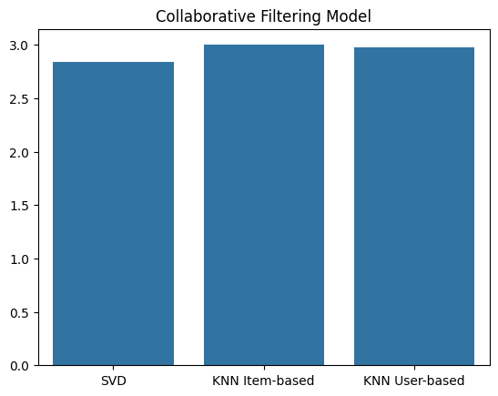
Collaborative filtering model
Based on collaborative filtering model, KNN User (score 2.88 ) is giving better performance compared to SVD(2.83) and KNN Item - 2.85)

Slide 6
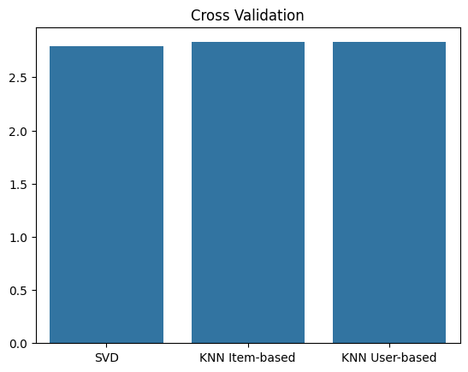
CROSS VALIDATION
Based on Cross validations, KNN User (score 2.80) is giving better performance compared to SVD(2.79) and KNN Item - 2.77)

